Slide 1






Powerplays and Predictions: Unlocking IPL Intelligence - Scikit-learn and IPL Match Winner Prediction
Sara Verkiyani, Ashwin Shastry Paturi, Akarsh Lakshmana, Divakar Reddy Ravi Team 09 - CS506 02 IN - Spring 2025 Computer Science
School of Technology & Computing (STC)

Slide 2
Agenda
Introduction
Dataset Overview
Summary of Key Insights
Supervised Learning
Supervised Learning
Unsupervised Learning
Q&A

Slide 3
Dataset Overview
This project demonstrates the application of Scikit-learn to predict the outcome of IPL cricket matches.
We used supervised and unsupervised learning methods with historical IPL data.
Notes:
These steps ensured clean, structured data ready for meaningful analysis.

Slide 4
Dataset Description
- Dataset: all_season_summary.csv
- Features: home_team, away_team, toss_won, venue_name
- Target: match winner
- Preprocessing: missing value removal and label encoding
Notes:
These steps ensured clean, structured data ready for meaningful analysis.

Slide 5
Data Visualization – Tools and Techniques
- Used matplotlib and seaborn libraries for visual representation of data and model performance.
- Plotted heatmaps to display confusion matrices for both Random Forest and Logistic Regression models.
- Used scatter plots to visualize KMeans clustering of match data based on team performance (runs and wickets).
- Visualization helped identify patterns, misclassifications, and overall model behavior.

Slide 6
Feature Engineering & Validation
- Selected key match-related features: home_team, away_team, toss_won, venue_name.
- Applied Label Encoding to convert categorical variables into numerical format.
- Handled missing values by removing rows with NaN entries in selected features.
- Used train_test_split to divide the data (80% training, 20% testing).
- Set random_state to ensure reproducibility across runs.
- Validation metrics: accuracy score and confusion matrix to evaluate model predictions.
Notes:
These steps ensured clean, structured data ready for meaningful analysis.

Slide 7
Summary of Key Insights
- Random Forest and Logistic Regression were effective in predicting match outcomes with good accuracy.
- Venue, toss winner, and team composition are strong predictors in IPL matches.
- KMeans clustering revealed performance-based groupings of matches.
- Confusion matrix visualizations helped identify common misclassifications.
- Feature engineering and proper validation played a key role in model success.
- Future models can be improved using player-level statistics and recent team form.

Slide 8
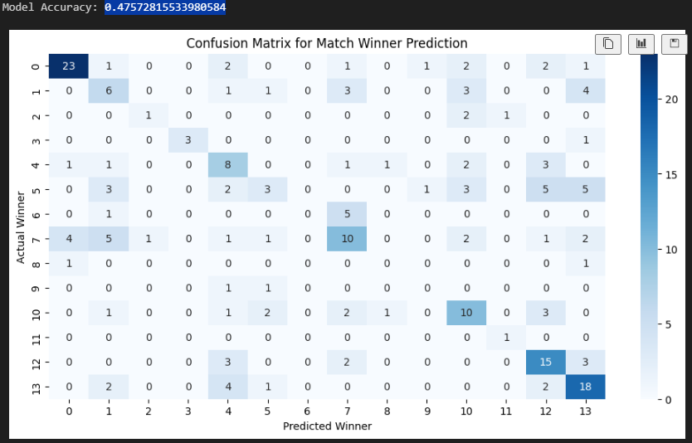
Supervised Learning: Random Forest Classifier
- Trained on 80% of the dataset
- Accuracy achieved: 0.47572815533980584
- Used to predict match winner based on selected features
Notes:
These steps ensured clean, structured data ready for meaningful analysis.

Slide 9
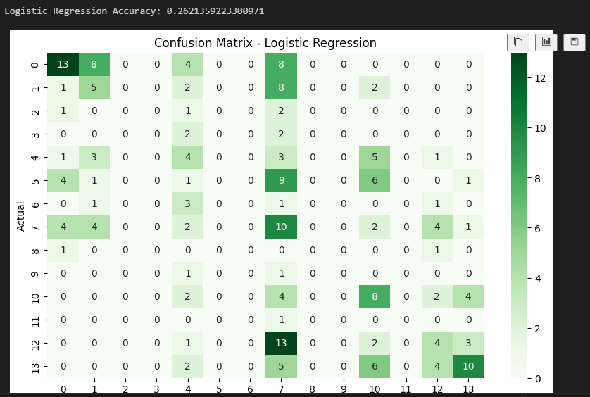
Supervised Learning: Logistic Regression
Second classification model for comparison
- Simpler, linear model for baseline performance
- Accuracy: 0.2621359223300971
Notes:
Grouping and aggregation allowed us to identify team strategies and dominant play styles.

Slide 10
Unsupervised Learning: KMeans Clustering
Clustered matches based on run and wicket stats
- Used StandardScaler for normalization
- Visualized clusters using scatter plot

Slide 11
Model Evaluation
Metrics used: Accuracy, Confusion Matrix
- Visualized confusion matrices using heatmaps
- Identified which teams were often misclassified

Slide 12
Conclusion
This project successfully applied Scikit-learn models to sports data.
Both Random Forest and Logistic Regression showed good results.
Future work: use more features (player stats, current form), try hyperparameter tuning.

Slide 13
Reference
Pedregosa, F., Varoquaux, G., Gramfort, A., Michel, V., Thirion, B., Grisel, O., ... & Duchesnay, É. (2011). Scikit-learn: Machine learning in Python. Journal of Machine Learning Research, 12, 2825–2830. https://scikit-learn.org
McKinney, W. (2010). Data structures for statistical computing in Python. In Proceedings of the 9th Python in Science Conference (Vol. 445, pp. 51–56). https://pandas.pydata.org/
Hunter, J. D. (2007). Matplotlib: A 2D graphics environment. Computing in Science & Engineering, 9(3), 90–95. https://matplotlib.org/
Waskom, M. (2021). Seaborn: Statistical data visualization. Journal of Open Source Software, 6(60), 3021. https://seaborn.pydata.org/
Kaggle. (2022). Indian Premier League (IPL) All seasons. Retrieved from https://www.kaggle.com/datasets
Géron, A. (2019). Hands-On Machine Learning with Scikit-Learn, Keras, and TensorFlow (2nd ed.). O’Reilly Media.
Notes:
Grouping and aggregation allowed us to identify team strategies and dominant play styles.

Slide 14


Q&A

